Slide 1


Psychology
Chapter 1 INTRODUCTION TO PSYCHOLOGY

Slide 2


What is psychology?
Psychology is the scientific study of mind and behavior.

Slide 3
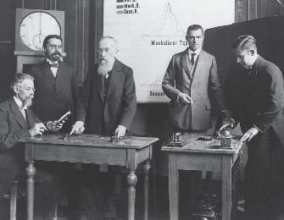
Wilhelm Wundt (1832-1920)
Transformed psychology from philosophy to science
Used scientific methods to study consciousness
Opened first psychology research laboratory – 1879
Notes:
3

Slide 4
Structuralism
Early Advocate: Edward Titchener
Goals: Study conscious experience and its structure
Methods: Experiments and introspection
Application: Pure scientific research
Notes:
4

Slide 5

Be an Introspector
When the object appears above:
Ignore what this object is.
Try to describe only your experience of it.
Notes:
5

Slide 6
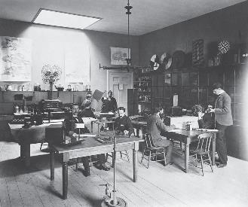
Functionalism
Early Advocate: William James
Goals: Study how the mind allows an organism to adapt to the environment
Emphasized functions of thought
Methods: Naturalistic observation
Applications:
Educational, evolutionary, child, & industrial psychology
Study of individual differences
Notes:
6

Slide 7
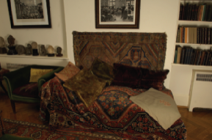
Psychoanalysis
Early Advocate: Sigmund Freud
Goals:
Explain personality and behavior through psychological processes
Emphasize importance of childhood in development of personality
Methods: Case study
Applications: Psychotherapy
Freud’s consulting room
Notes:
7

Slide 8
Gestalt Psychology
Early Advocates: Max Wertheimer; Kurt Koffka;
Wolfgang Köhler
Goals: Describe the organization of consciousness
“The whole is greater than the sum of its parts.”
Methods: Observation of sensory/perceptual phenomena
Applications:
Understanding learning and cognition
Understanding of visual illusions
Notes:
8

Slide 9


Slide 10
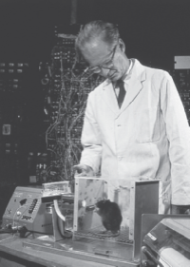
Behaviorism
Early Advocates: John B. Watson; B. F. Skinner
Goals:
Study only observable behavior
Explain behavior via learning principles
Methods: Observe the relationship between environmental stimuli and behavioral responses
Applications:
Behavior modification
Improved teaching methods
Behavioral therapy
Notes:
10

Slide 11
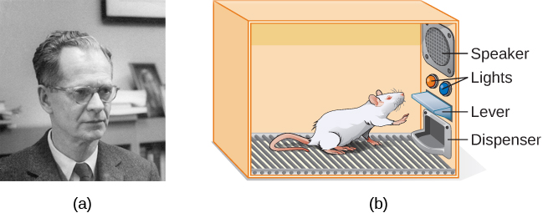
Figure 1.7
B. F. Skinner is famous for his research on operant conditioning.
Modified versions of the operant conditioning chamber, or Skinner box, are still widely used in research settings today. (credit a: modification of work by "Silly rabbit"/Wikimedia Commons)

Slide 12
Approaches to the Science of Psychology
Why don’t all psychologists explain behavior in the same way?
Notes:
12

Slide 13
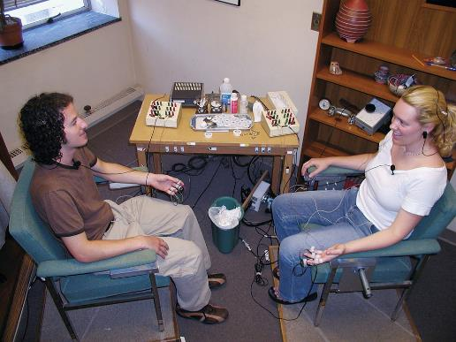
The Biological Approach
Focuses on the psychological effects of hormones, genes, and the activity of the nervous system, esp. the brain.

Slide 14
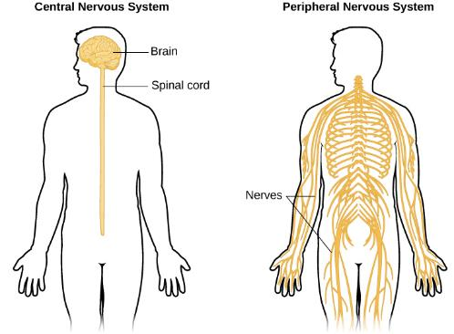
Figure 1.11
Biological psychologists study how the structure and function of the nervous system generate behavior.

Slide 15
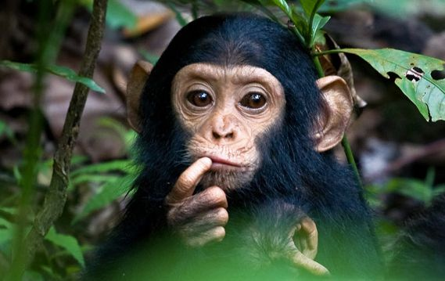
The Evolutionary Approach
Behavior and mental processes are the result of evolution.
It’s all about survival!

Slide 16

The Psychodynamic Approach
According to the psychodynamic approach, what you see may reflect your unconscious thoughts, wishes, and impulses.

Slide 17
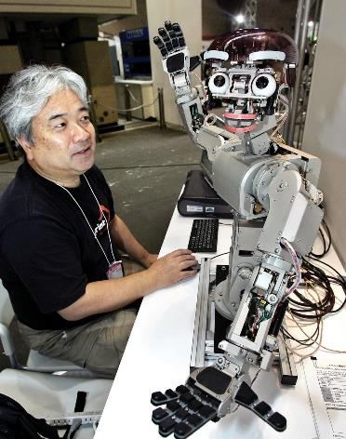
The Cognitive Approach
How we take in, mentally present, and store info
How we perceived and process info
How all these cognitive processes affect our behavior

Slide 18

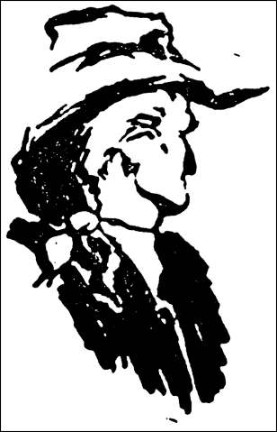
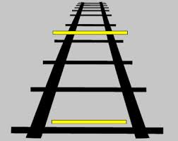

Slide 19
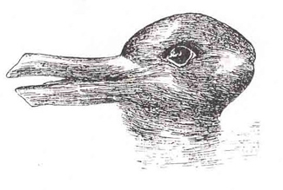
Figure 1.12
When you look at this image, you may see a duck or a rabbit. The sensory information remains the same, but your perception can vary dramatically.

Slide 20

The Behavioral Approach Why is He So Aggressive?
Focuses on observable behavior and on how that behavior is learned.
Psychologists taking a behavioral approach say that aggressiveness may be learned when children are rewarded for aggressive behavior.

Slide 21
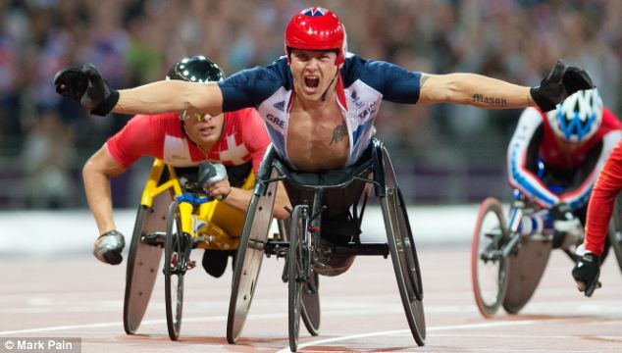
The Humanistic Approach
See behavior as determined primarily by each person’s capacity to choose how to think and act.
Has been criticized for being too vague and not testable, but inspired theories and research in positive psychology.
Back to TOC

Slide 22
Subfields of Psychology
Biological
Cognitive
Engineering
Developmental
Personality
Clinical
Counseling
Community
Health
Neuroscience
Educational
School
Social
Industrial and Organizational
Quantitative
Sports
Forensic
Environmental

Slide 23
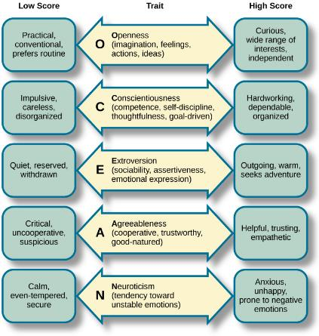
Figure 1.14
Each of the dimensions of the Five Factor model is shown in this figure. The provided description would describe someone who scored highly on that given dimension. Someone with a lower score on a given dimension could be described in opposite terms.

Slide 24
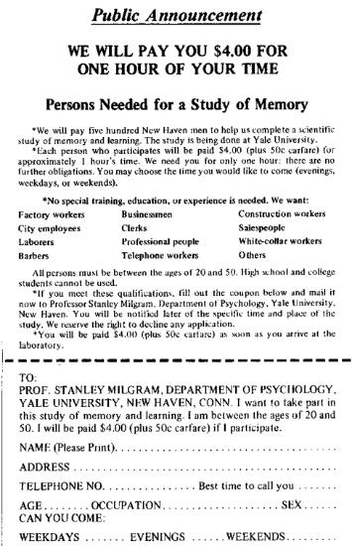
Figure 1.15
Stanley Milgram’s research demonstrated just how far people will go in obeying orders from an authority figure. This advertisement was used to recruit subjects for his research.

Slide 25
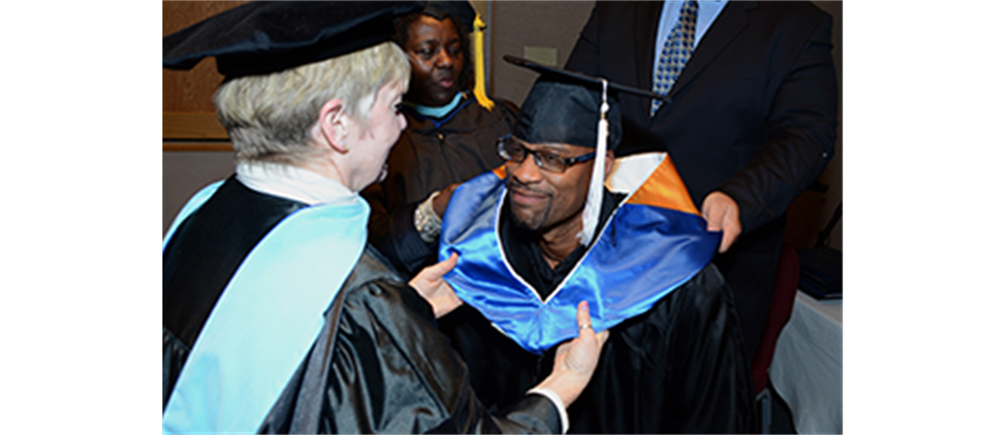
Where Do Psychologists Work?
Colleges, Universities, & Professional Schools
Mental Health Facilities
Private Practice
Business, Government, and Organizations
Schools
Other Settings

